Slide 1

GROUP 4
Training Hours vs Everything
Analyzing the Impact of AI Training on Business Performance
Team Members
1. Joydip Deb
2. Akshita Raj
3. Srujan
4. Heerak Tiwari
5. Nirattya Biswas

Slide 2
ACADEMIC RESEARCH PROJECT
Training Hours vs Everything
Analyzing the Impact of AI Training on Business Performance
Organizations invest heavily in AI tools and employee training, yet clear evidence of training effectiveness remains elusive. Decision-makers struggle to determine whether increased training hours translate into measurable business outcomes. This research analyzes the relationship between AI training hours and business performance metrics using real corporate AI adoption data.
Notes:
1

Slide 3

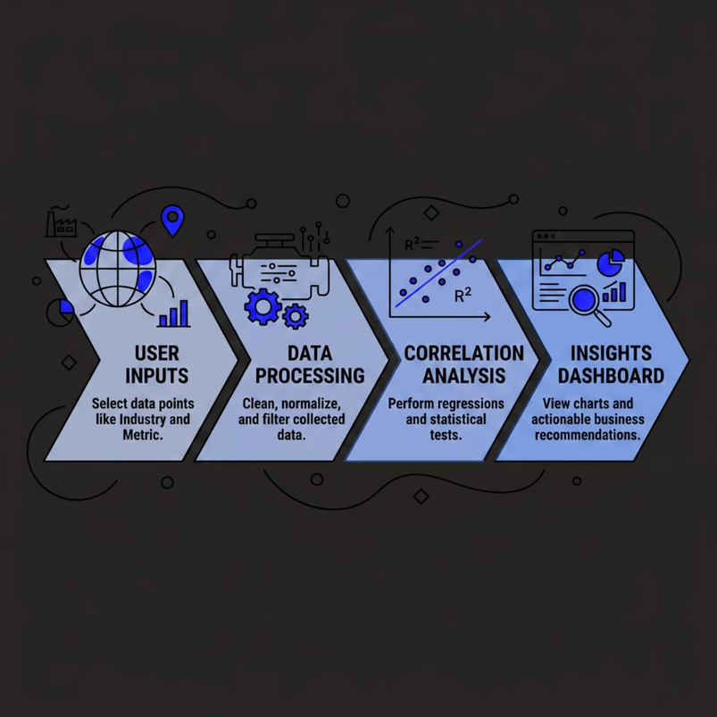
PROPOSED SOLUTION
A Data-Driven Web Application
We propose a web application that enables organizations to evaluate the impact of AI training investments on business outcomes through interactive analysis and statistical modeling.
Application Capabilities
Processing Pipeline
Select Industry, Country, and Business Metric
Analyze corporate AI adoption datasets
Compare training hours with performance data
Visualize trends through interactive charts
Calculate correlation scores via statistical analysis
Generate actionable business insights
we are using 2 dataset
Expected Outcome: Data-driven evidence to help organizations optimize AI training investments and improve overall business performance.
Notes:
2

Slide 4






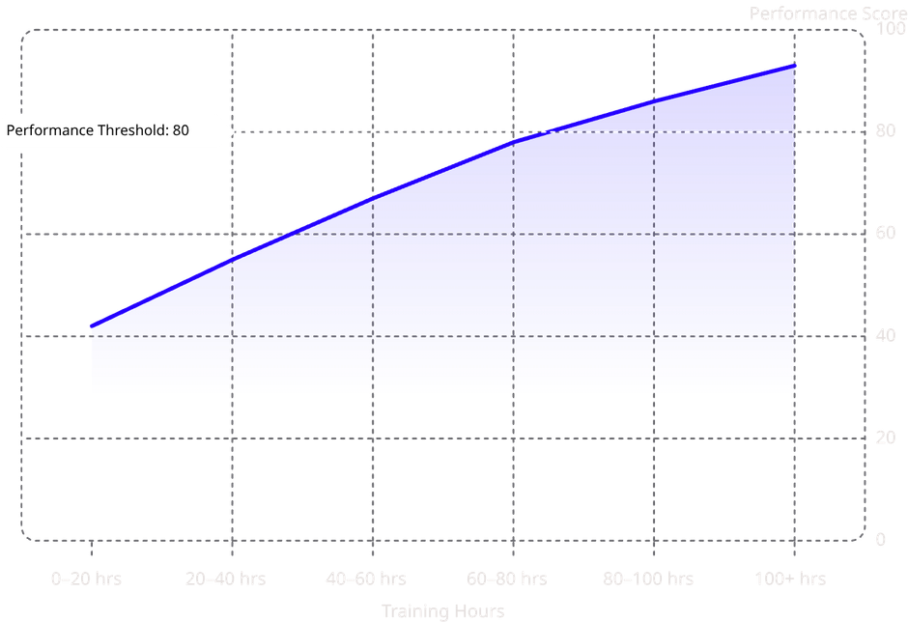
KEY FEATURES
Core Capabilities of the Platform
Six core features enable organizations to evaluate AI training impact with precision and clarity.
Industry-wise Analysis
Country-wise Analysis
Filter datasets by sector to uncover industry-specific training patterns.
Compare AI adoption and training effectiveness across geographic regions.
Interactive Visualization
Correlation Score Calculation
Explore dynamic charts revealing trends between training hours and performance.
Generate statistical correlation scores quantifying training-to-performance relationships.
Business Performance Insights
Comparative Trend Analysis
Surface actionable findings to guide training budget allocation.
Benchmark training strategies against peer organizations over time.
Illustrative Correlation
Training hours and performance scores show a positive correlation across industries. The trend line indicates diminishing returns beyond 100 hours.
Notes:
3

Slide 5
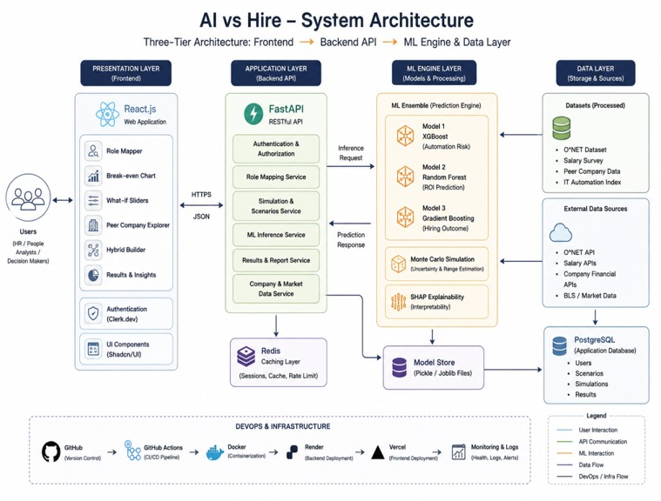
SYSTEM ARCHITECTURE
End-to-End Platform Architecture
The platform follows a three-tier architecture separating concerns across presentation, application, and data layers for scalability and maintainability.
Frontend Layer
Backend & Analytics Layer
React.js delivers a responsive interface with Recharts for dynamic data visualization. Users interact with filters and charts in real time.
FastAPI handles requests and orchestrates data workflows. Pandas processes datasets while linear regression computes correlation scores.
Notes:
4

Slide 6
TECHNOLOGY STACK
Modern, Open-Source Technology Stack
The platform is built entirely on open-source technologies selected for performance, ecosystem maturity, and suitability for data-intensive analytical workloads.
Category
Technology
Frontend
React.js · Recharts
Backend
FastAPI (Python)
Data Processing
Pandas
Machine Learning
XGBoost , Random Forest , Gradient Boost , Monte Carlo Simulation, Shap Explainability
Version Control
GitHub
Why This Stack?
Design Principles
FastAPI offers high-performance async capabilities ideal for analytical workloads. React and Recharts provide a polished, interactive frontend. Pandas and statistical methods ensure rigorous, reproducible analysis.
Modular architecture for independent component scaling
RESTful API design for clean frontend-backend separation
Statistically rigorous analytical methods
Fully open-source and reproducible
Notes:
5

Slide 7
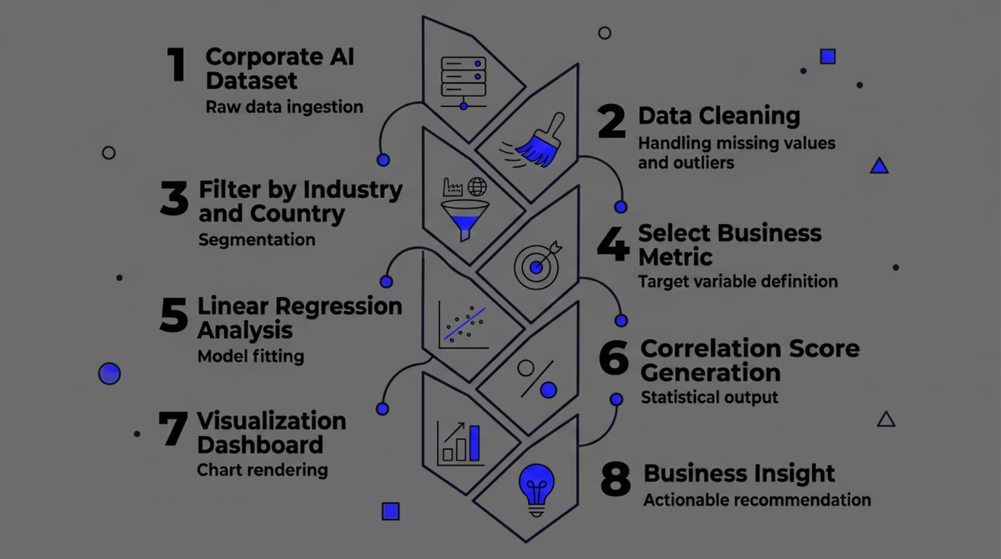
PROJECT WORKFLOW
From Raw Data to Business Insight
The analytical pipeline transforms raw corporate AI adoption data into evidence-based recommendations through a structured, seven-stage workflow.
📊 Example Insight
"Healthcare companies in India with more than 100 training hours achieved significantly higher productivity gains than companies with fewer than 40 hours of training — representing a measurable return on AI education investment."
🔍 Reproducible
📈 Scalable
🎯 Actionable
Every analytical step is documented and version-controlled via GitHub.
Architecture supports additional datasets, industries, and metrics over time.
Outputs are designed for direct use by L&D teams and executives.
Notes:
6

